Slide 1
أكـــــاديميــــة طــــويـــق
Deep Learning

Slide 2
Training Neural Networks
From Forward Propagation to Optimizers
By: Dr. Afshan Hashmi

Slide 3
Course Objectives:
Understand the biological inspiration behind artificial neural networks and how they relate to human brain structure.
Describe the structure and function of a perceptron and multi-layer perceptrons (MLPs).
Differentiate between common activation functions (ReLU, Sigmoid, Tanh, Softmax) and understand when to use them.
Explain the training process of neural networks, including forward propagation, loss computation, backpropagation, and optimization.
Implement and train a simple neural network model using Python and Keras on real-world datasets.

Slide 4
Forward Propagation
The process where input data passes through the network to generate predictions.
What Happens?
Inputs pass through each layer (using weights, biases, activation functions)
Each neuron outputs a value to the next layer
Final output is used to make predictions
Mathematically:
z=w⋅x+b
a=activation(z)
Example:
Input Layer Hidden Layer Output
x₁=0.5 \
→ z = (0.5×0.1 + -1.2×-0.3) + 0.2 = 0.61 → σ(0.61) = 0.648
x₂=-1.2 /
Where ,
X = [0.5, -1.2]
W = [0.1, -0.3]
bias = 0.2

Slide 5
Loss Computation
Purpose: Measure how far the prediction is from the true value.
Common Loss Functions:
Mean Squared Error (MSE): For regression L=1/n∑(y_{true}−y_{pred})²
Categorical Crossentropy: For multi-class classification L=−∑y_{true}log⁡(y_{pred})
Loss Function | Formula | Use Case
Mean Squared Error (MSE) | 1/n∑(y_{pred}−y_{true})² | Regression
Cross-Entropy | −∑y_{true}log⁡(y_{pred}) | Classification

Slide 6
Backpropagation
Goal: Find how each weight contributed to the loss, then adjust it.
How?
Use chain rule of calculus to compute derivatives of loss w.r.t. weights.
Gradients flow backward from output layer to input layer.
Step-by-Step Process:
Compute loss derivative w.r.t. output:
For MSE: ∂L/∂y_pred = 2(y_pred - y_true)
Calculate activation derivative:
Sigmoid: ∂σ(z)/∂z = σ(z)(1 - σ(z))
Determine weight gradients:
∂L/∂wᵢ = (∂L/∂y_pred)·(∂y_pred/∂z)·(∂z/∂wᵢ)

Slide 7
Backpropagation
Numerical Example: Given:
y_true = 1, y_pred = 0.7
x = 0.5, w = 0.8, b = 0.1
Calculations:
∂L/∂y_pred = 2(0.7 - 1) = -0.6
∂y_pred/∂z = 0.7(1-0.7) = 0.21
∂z/∂w = x = 0.5
∂L/∂w = -0.6 × 0.21 × 0.5 ≈ -0.063

Slide 8
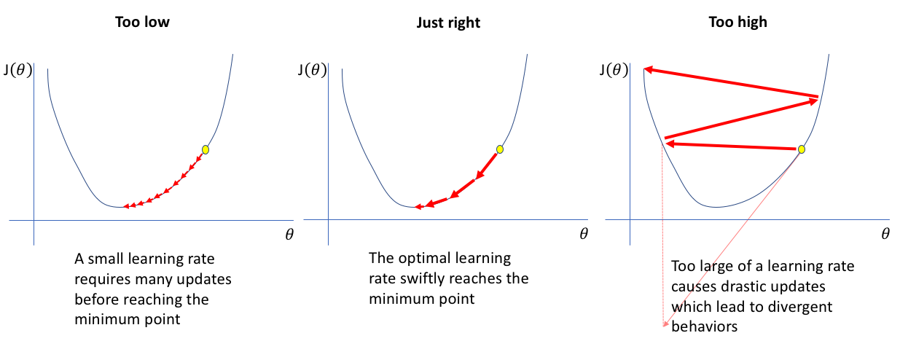
Backpropagation
2.2 Gradient Descent Optimization
Updates weights to minimize loss:
Weight Update Rule:
w_new = w_old - η·(∂L/∂w) Where η is the learning rate.
Visualization of Convergence:
Learning Rate Effects:
Too small: Slow convergence
Too large: May overshoot minimum

Slide 9
Optimization Algorithms
Why Optimization Algorithms?
Improve convergence speed
Handle noisy gradients
Adapt learning rates
Common Optimizers
1. SGD (Stochastic Gradient Descent)
Updates weights using one (or a few) data points at a time
Faster than batch gradient descent
Pros: Simple and efficient Cons: May get stuck in local minima, noisy updates
2. Adam (Adaptive Moment Estimation)
Combines momentum + adaptive learning rates
Maintains running averages of gradients and squared gradients
Pros: Fast, widely used, works well in practice Cons: Can overfit if not regularized

Slide 10
Optimization Algorithms
RMSprop
Similar to Adam but slightly simpler
Adapts learning rate based on recent gradients
Pros: Good for recurrent networks Cons: Hyperparameter tuning required
Momentum Accelerates gradient descent by remembering past gradients Helps updates move consistently in one direction
Pros: Faster convergence, reduces oscillations Cons: Needs tuning of momentum coefficient (usually 0.9)
Algorithm | Update Rule | Advantages | Disadvantages
SGD | w = w - η·∇L | Simple | Slow convergence
Momentum | v = βv + (1-β)∇L w = w - ηv | Reduces oscillations | Extra parameter (β)
RMSprop | s = γs + (1-γ)(∇L)² w = w - η(∇L/√(s+ε)) | Adapts learning rates | Sensitive to γ
Adam | Combines Momentum + RMSprop | Fast convergence | Multiple hyperparameters

Slide 11
Common Challenges and Solutions
Vanishing / Exploding Gradients
Problem: Gradients become too small or too large during backpropagation, making learning unstable or very slow.
Causes:
Deep networks
Sigmoid/Tanh activations
Improper initialization
Solutions:
Use ReLU activation instead of Sigmoid/Tanh
Apply Batch Normalization to stabilize layer inputs
Use Residual Connections (as in ResNet) to ease gradient flow

Slide 12
Common Challenges and Solutions
5.2 Overfitting
Problem: Model performs well on training data but poorly on unseen data.
Causes:
Too complex models
Insufficient training data
Lack of regularization
Prevention Methods:
Use L1/L2 Regularization to penalize large weights
Add Dropout Layers to randomly deactivate neurons during training
Apply Data Augmentation to artificially increase dataset diversity
5.3 Learning Rate Selection
Problem: Too high = overshooting minimum Too low = slow convergence or getting stuck
Strategies:
Use Learning Rate Schedules to gradually decrease learning rate
Try Cyclical Learning Rates (oscillate between a range)
Use Adaptive Optimizers like Adam, RMSprop

Slide 13
Practical Implementation
TensorFlow/Keras Example
model = tf.keras.Sequential([tf.keras.layers.Dense(64,activation='relu'),tf.keras.layers.Dense(1,activation='sigmoid')])
model.compile(optimizer=tf.keras.optimizers.Adam(learning_rate=0.001),loss='binary_crossentropy',metrics=['accuracy'])
history = model.fit(X_train, y_train, epochs=10)
Monitoring Training
Key Metrics to Track:
Training loss
Validation loss
Accuracy/other task-specific metrics
Early Stopping Implementation:
early_stopping = tf.keras.callbacks.EarlyStopping(
monitor='val_loss',
patience=3,
restore_best_weights=True
)

Slide 14

Summary
Forward Propagation: Input data flows through the network, layer by layer, producing an output (prediction).
Loss Computation: Compares predicted output with true labels to calculate the model’s error.
Backpropagation: Uses the chain rule to compute how much each weight contributed to the error and calculates gradients.
Gradient Descent: Updates the weights in the opposite direction of the gradient to reduce error over time.
Optimization Algorithms:
SGD (Stochastic Gradient Descent): Updates weights using a few samples at a time.
Adam: Combines momentum and adaptive learning rates — most commonly used.
RMSprop: Good for sequences and time-series data; adjusts learning rates dynamically.
Training is an iterative process where the model continuously learns by minimizing the error until it achieves the best possible performance on the data.

Slide 15
Practice with Google COLAB
Click here
https://colab.research.google.com/drive/1q6eotKITDVzktiE8euBlTQjdi_rbYWCq

Slide 16
Books and References
"Deep Learning" by Ian Goodfellow, Yoshua Bengio, and Aaron Courville
"Neural Networks and Deep Learning" by Michael Nielsen
"Hands-On Machine Learning with Scikit-Learn, Keras, and TensorFlow" by Aurélien Géron
Keras Documentation Official documentation for building neural networks using Keras.
TensorFlow Tutorials Official tutorials for implementing and training neural networks.

Slide 17

















الشراكات العالمية

Slide 18
شــــــكــــرًا لكــــــم
THANK YOU

